Slide 1

CSCI E-96 Data Mining, Discovery and Exploration Efficient Similarity Search
Steve Elston
Copyright 2021, 2022, 2023, 2024, 2025, Stephen F Elston. All rights reserved.

Slide 2
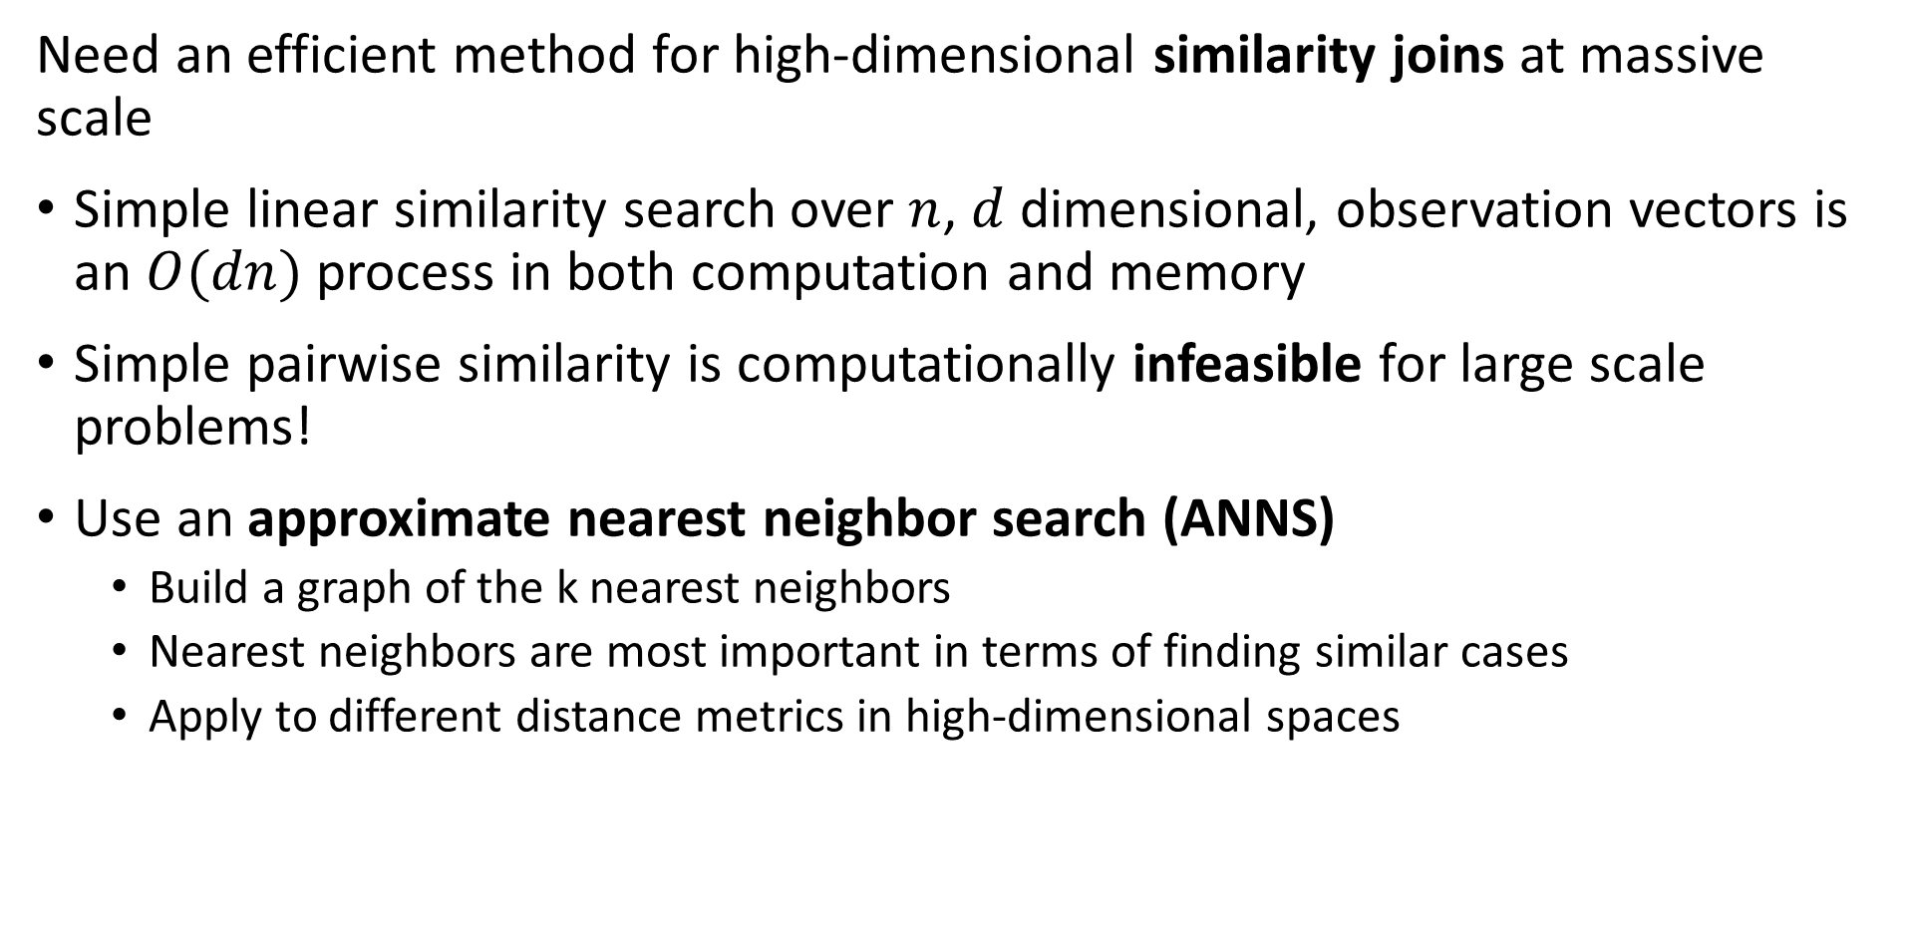
Similarity Search at Scale
Need an efficient method for high-dimensional similarity joins at massive scale
Simple linear similarity search over $n$, $d$ dimensional, observation vectors is an $O(dn)$ process in both computation and memory
Simple pairwise similarity is computationally infeasible for large scale problems!
Use an approximate nearest neighbor search (ANNS)
Build a graph of the k nearest neighbors
Nearest neighbors are most important in terms of finding similar cases
Apply to different distance metrics in high-dimensional spaces

Slide 3
Similarity Search at Scale
Need an efficient method for high-dimensional similarity joins at massive scale
Constructing nearest-neighbor graphs
Retrieval Augmented Generation (RAG) models for generative AI
Cluster models
Dimensionality reduction
Find similar products and for recommendation
Find similar documents
Web search
Document search
Deduplication
Plagiarism detection
Search for similar images

Slide 4
Similarity Search at Scale
Pipeline for similarity joins at massive scale
Our goal is to find rapidly approximate nearest neighbors with high recall
No one method can achieve this goal
In practice use a pipeline which concatenates several methods
Distance (Similarity) Metric
Dimensionality Reduction (Embedding)
Create D dimensional numeric embedding vectors
PCA
Neural Embedding
Etc.
Coarse Quantization
Reduce scope for ANN search
Inverted file - IVF
IVF Product quantization (IVF-PQ)
Inverted Multi-Index (IMI)
IVF Hierarchical Navigable Small Worlds (HNSW)
Etc…
Fine Quantizaton
Further reduce search scope and improve recall
Exhaustive search – Flat
Residual PQ
Locally Sensitive Hashing (LSH)
Search Refinemnet
Increase recall for NN search
Flat
Residual PQ algorithm

Slide 5
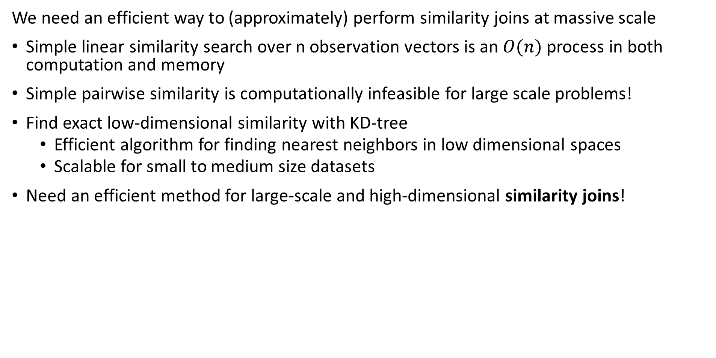
Similarity Search at Scale
We need an efficient way to (approximately) perform similarity joins at massive scale
Simple linear similarity search over n observation vectors is an $O(n)$ process in both computation and memory
Simple pairwise similarity is computationally infeasible for large scale problems!
Find exact low-dimensional similarity with KD-tree
Efficient algorithm for finding nearest neighbors in low dimensional spaces
Scalable for small to medium size datasets
Need an efficient method for large-scale and high-dimensional similarity joins!

Slide 6
Similarity Search at Scale
We need an efficient way to (approximately) perform similarity joins at massive scale
Need an efficient method for large-scale and high-dimensional similarity joins!
Broadly, there are four classes of ANNS algorithms
Tree search
Hash-based search
Quantization-based search
Graph search
Apply to appropriate distance metrics in high-dimensional spaces

Slide 7
Similarity Search at Scale
Dimensionality reduction often applied to similarity serarch
It is easier to search in a lower-dimensional space
Many possible transformations to lower-dimensional embedding space
Some algorithms start with a nearest neighbor similarity search!
Can use a neural network to find an embedding space, but computationally intensive
Ideally want an orthogonal embedding space
More on dimensionality reduction in other lessons

Slide 8
Flat Similarity Search

Slide 9
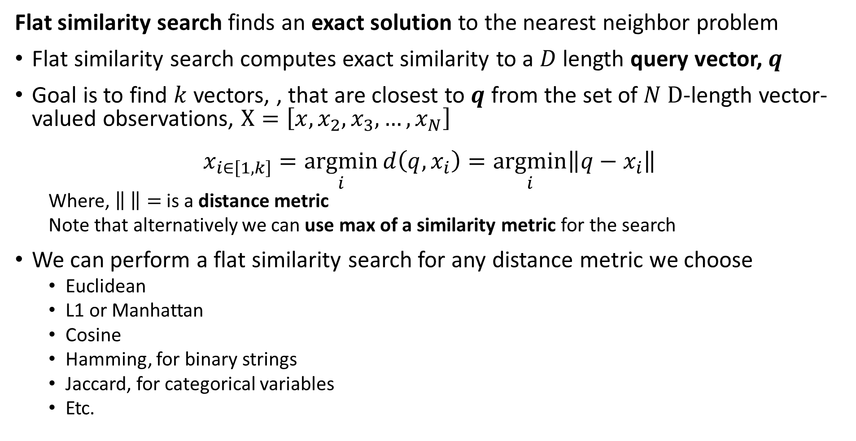
Flat similarity search finds exact solution
Flat similarity search finds an exact solution to the nearest neighbor problem
Flat similarity search computes exact similarity to a $D$ length query vector, $q$
Goal is to find $k$ vectors, , that are closest to $q$ from the set of $N D$-length vector-valued observations, $X=\left[x,x_{2},x_{3},…,x_{N}\right]$
$$x_{i∈\left[1,k\right]}=\underset{i}{argmin}{d\left(q, x_{i}\right)}=\underset{i}{argmin}{{\left\|q−x_{i}\right\|}^{ }}$$
Where, $\left\| \right\|=$ is a distance metric
Note that alternatively we can use max of a similarity metric for the search
We can perform a flat similarity search for any distance metric we choose
Euclidean
L1 or Manhattan
Cosine
Hamming, for binary strings
Jaccard, for categorical variables
Etc.

Slide 10
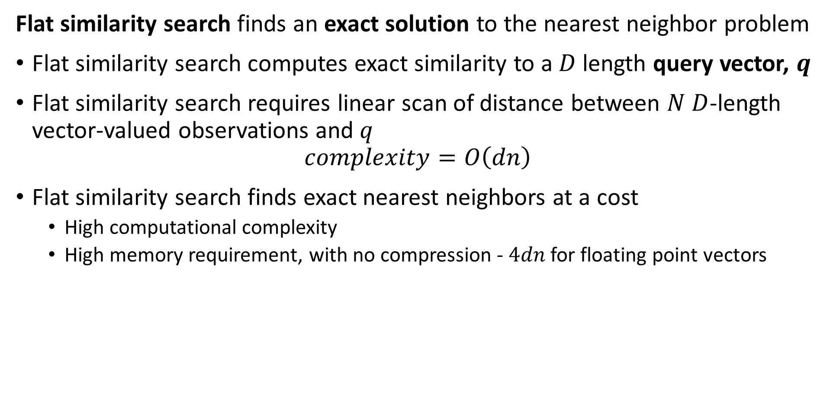
Flat similarity search finds exact solution
Flat similarity search finds an exact solution to the nearest neighbor problem
Flat similarity search computes exact similarity to a $D$ length query vector, $q$
Flat similarity search requires linear scan of distance between $N$ $D$-length vector-valued observations and $q$
$$complexity=O\left(dn\right)$$
Flat similarity search finds exact nearest neighbors at a cost
High computational complexity
High memory requirement, with no compression - $4dn$ for floating point vectors

Slide 11
Flat similarity search finds exact solution
Is any similarity search truly exact?
Unlikely!
Distance is dependent on the distance metric used
Dimensionality reduction (embedding) provides only an approximate representation of original vector
Vector valued observations are subject to noise
In reality we only need an NN similarity search good enough for our task

Slide 12
Evaluation of ANNS

Slide 13
Evaluation of ANNS
How do we objectively evaluate ANNS algorithms
There are three dimensions of performance
Recall measures the fraction of true NNs found by the algorithm
Memory use can be the biggest constraint for massive data sets
Speed can be important for many applications
Is an invariable trade off between these three dimensions
Example, we can have high recall if we have sufficient memory and computational capacity
Generally we must pick two of the three dimensions and accept the third
Low Memory -Scalable
?
Low Computational Complexity-Scalable
High Recall -Accuracy

Slide 14
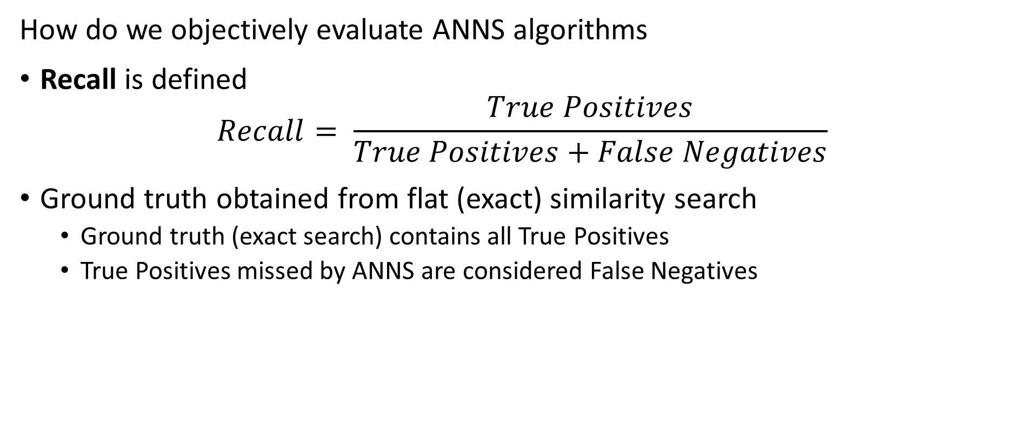
Evaluation of ANNS
How do we objectively evaluate ANNS algorithms
Recall is defined
$$Recall= \frac{True Positives}{True Positives+False Negatives}$$
Ground truth obtained from flat (exact) similarity search
Ground truth (exact search) contains all True Positives
True Positives missed by ANNS are considered False Negatives

Slide 15
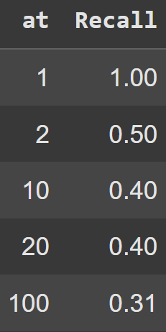
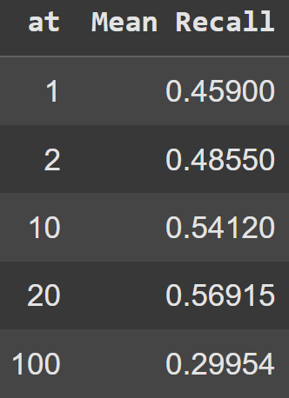
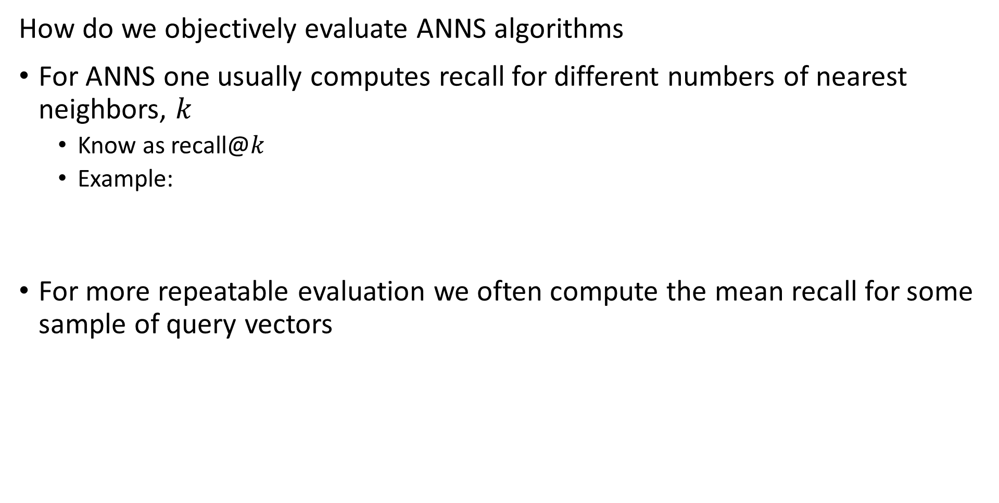
Evaluation of ANNS
How do we objectively evaluate ANNS algorithms
For ANNS one usually computes recall for different numbers of nearest neighbors, $k$
Know as recall@$k$
Example:
For more repeatable evaluation we often compute the mean recall for some sample of query vectors

Slide 16
Evaluation of ANNS
Benchmark datasets for ANNS algorithms

Slide 17
Inverted File Systems

Slide 18
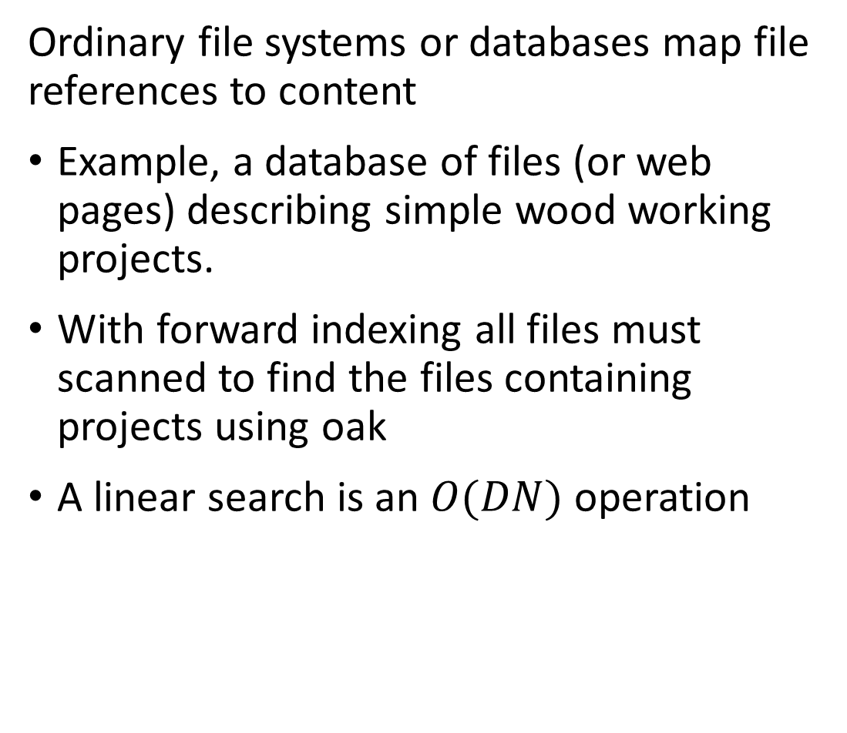
Inverted file systems enable look-up by value
Ordinary file systems or databases map file references to content
Example, a database of files (or web pages) describing simple wood working projects.
With forward indexing all files must scanned to find the files containing projects using oak
A linear search is an $O(DN)$ operation
File ID
101
102
103
104
105
106
107
108
109
110
111
112
113
114
115
Wood type
Oak
Pine
Oak
Maple
Fir
Maple
Fir
Oak
Maple
Fir
Maple
Pine
Maple
Oak
Oak

Slide 19
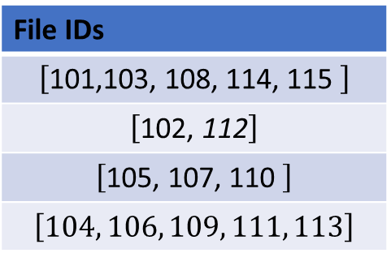
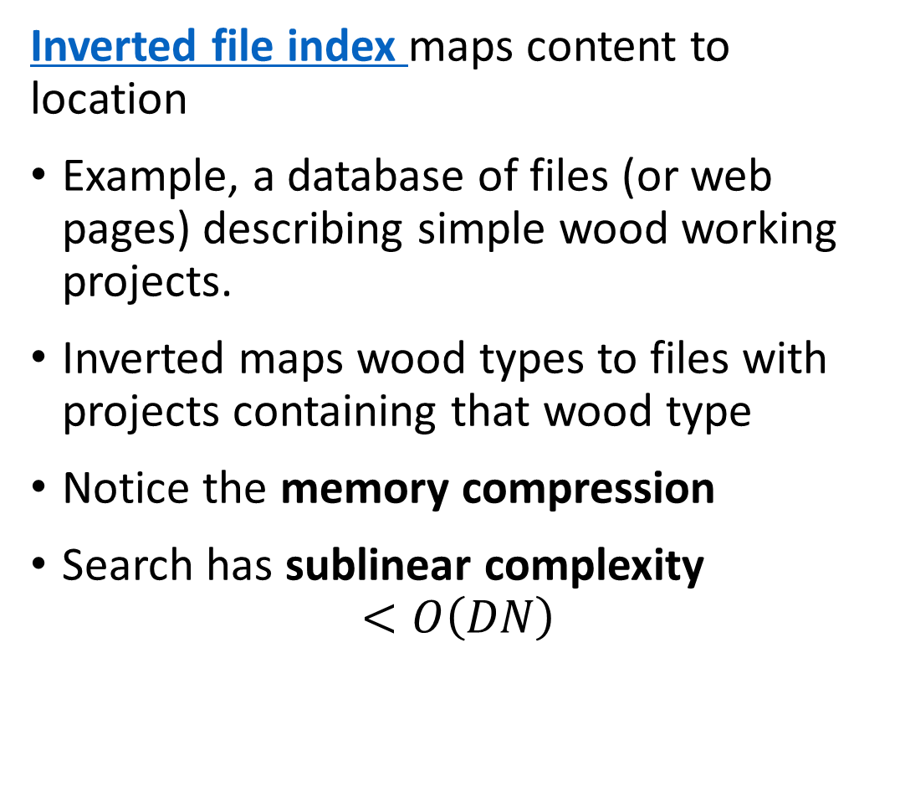
Inverted file systems enable look-up by value
Inverted file index maps content to location
Example, a database of files (or web pages) describing simple wood working projects.
Inverted maps wood types to files with projects containing that wood type
Notice the memory compression
Search has sublinear complexity
$$<O\left(DN\right)$$
Wood type
Oak
Pine
Fir
Maple
File IDs
$$\left[\text{101,}\text{103, }\text{108,} \text{114,} \text{115 }\right]$$
$$\left[\text{10}\text{2}\text{,}\text{ 112}\right]$$
$$\left[\text{10}\text{5}\text{, 1}\text{07}\text{, 11}\text{0} \right]$$
$$\left[104, 106, 109, 111, 113\right]$$

Slide 20
Coarse Quantization

Slide 21
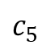
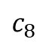
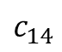
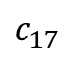
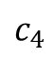
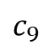
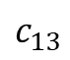
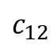
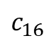
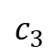
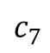
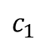
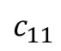
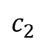
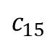
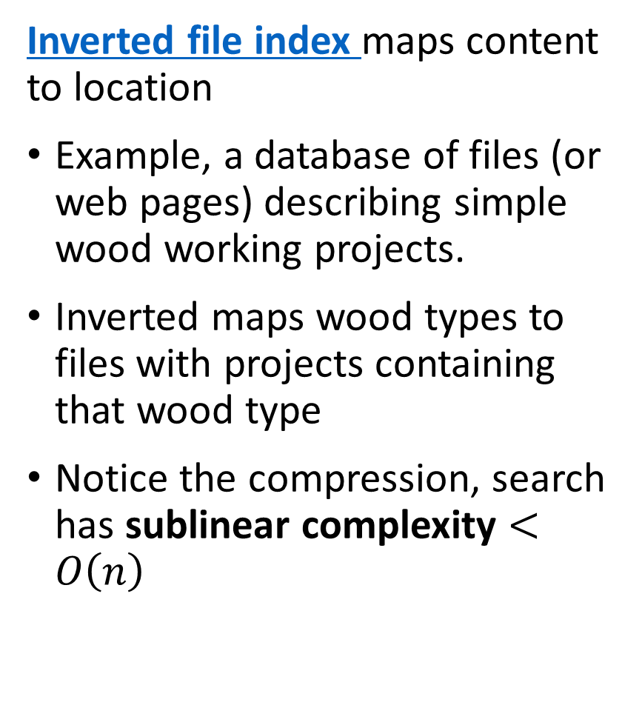
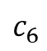
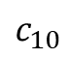
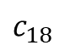
Coarse coding divides the search region
Inverted file index maps content to location
Example, a database of files (or web pages) describing simple wood working projects.
Inverted maps wood types to files with projects containing that wood type
Notice the compression, search has sublinear complexity $<O\left(n\right)$
$$c_{4}$$
$$c_{5}$$
$$c_{3}$$
$$c_{2}$$
$$c_{6}$$
$$c_{14}$$
$$c_{1}$$
$$c_{7}$$
$$c_{8}$$
$$c_{13}$$
$$c_{15}$$
$$c_{10}$$
$$c_{9}$$
$$c_{16}$$
$$c_{12}$$
$$c_{17}$$
$$c_{11}$$
$$c_{18}$$

Slide 22
Coarse quantizaton divides the search region
Coarse quantizatrion speeds NN search by reducing scope
To speed NN search by orders of magnitude limit scope of search
Coarse coding divides the search scope into small cells
Similar vectors are within the cells
Can use the cell ids in an inverted index for fast lookup of similar vectors

Slide 23
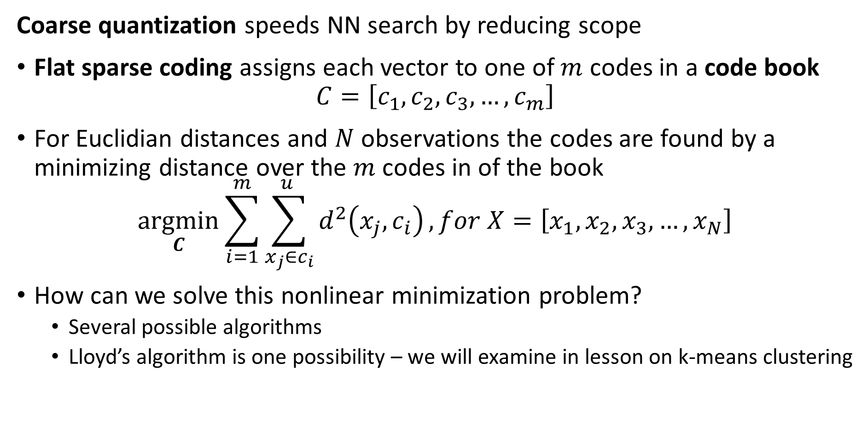
Coarse quantization divides the search region
Coarse quantization speeds NN search by reducing scope
Flat sparse coding assigns each vector to one of $m$ codes in a code book
$$C=\left[c_{1},c_{2},c_{3},…,c_{m}\right]$$
For Euclidian distances and $N$ observations the codes are found by a minimizing distance over the $m$ codes in of the book
$$\underset{C}{argmin}{\sum_{i=1}^{m}{\sum_{x_{j}∈c_{i}}^{u }{d^{2}\left(x_{j},c_{i}\right)}}}, for X=\left[x_{1},x_{2},x_{3},…,x_{N}\right]$$
How can we solve this nonlinear minimization problem?
Several possible algorithms
Lloyd’s algorithm is one possibility – we will examine in lesson on k-means clustering

Slide 24
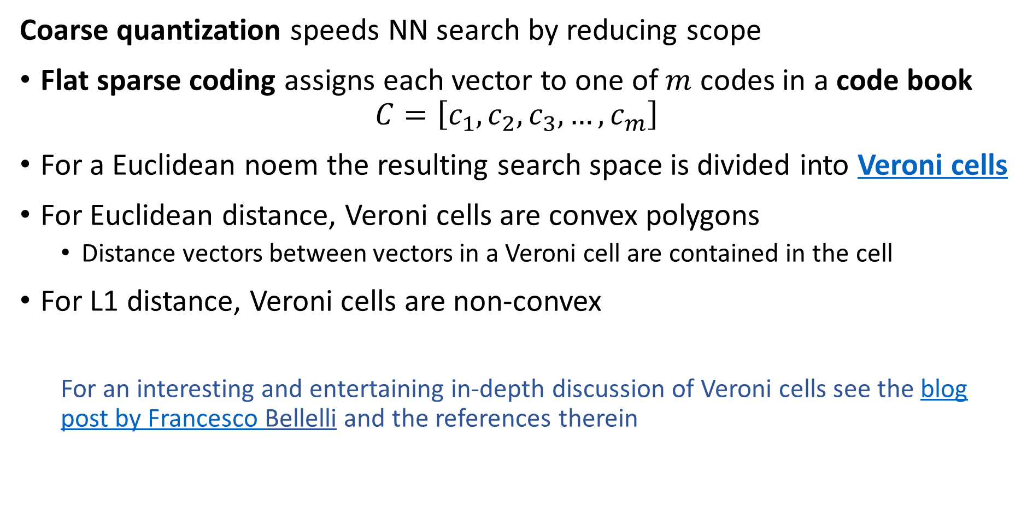
Coarse quantization divides the search region
Coarse quantization speeds NN search by reducing scope
Flat sparse coding assigns each vector to one of $m$ codes in a code book
$$C=\left[c_{1},c_{2},c_{3},…,c_{m}\right]$$
For a Euclidean noem the resulting search space is divided into Veroni cells
For Euclidean distance, Veroni cells are convex polygons
Distance vectors between vectors in a Veroni cell are contained in the cell
For L1 distance, Veroni cells are non-convex
For an interesting and entertaining in-depth discussion of Veroni cells see the blog post by Francesco Bellelli and the references therein

Slide 25
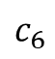
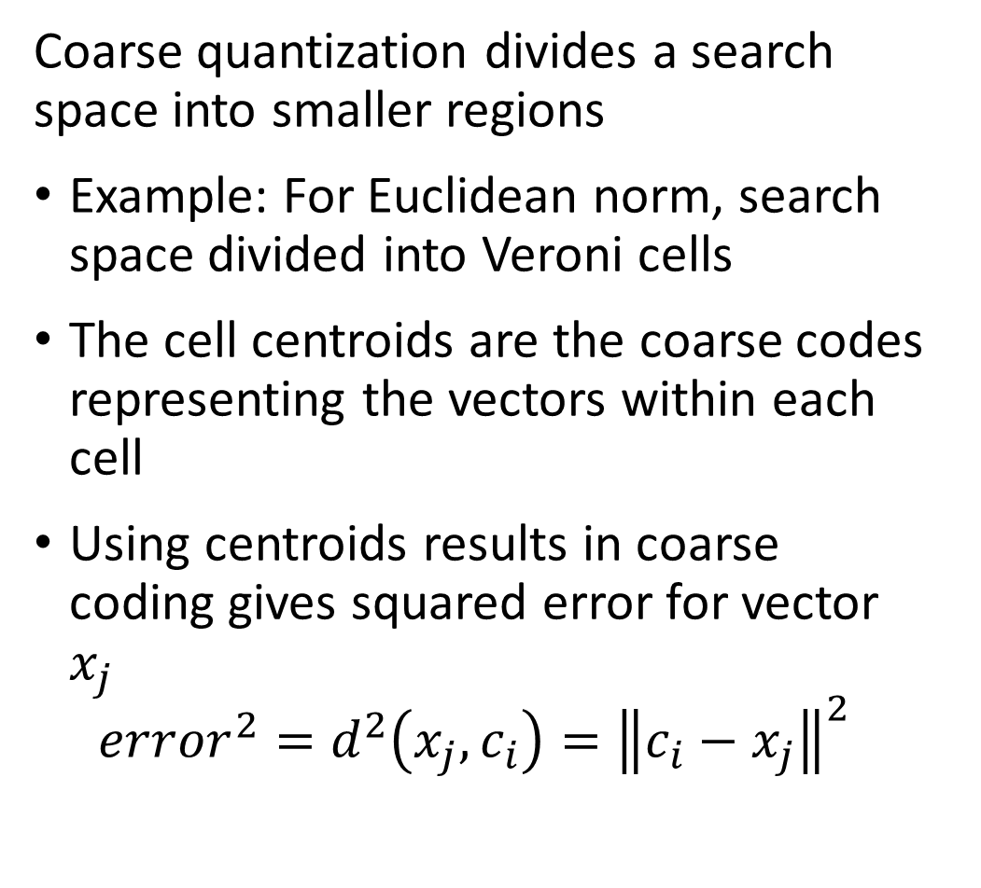
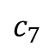
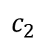
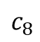
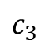
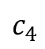
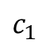
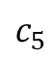
Coarse quantization divides the search region
Coarse quantization divides a search space into smaller regions
Example: For Euclidean norm, search space divided into Veroni cells
The cell centroids are the coarse codes representing the vectors within each cell
Using centroids results in coarse coding gives squared error for vector $x_{j}$
$${error}^{2}=d^{2}\left(x_{j},c_{i}\right)={\left\|c_{i}−x_{j}\right\|}^{2}$$
$$c_{3}$$
$$c_{2}$$
$$c_{7}$$
$$c_{1}$$
$$c_{4}$$
$$c_{8}$$
$$c_{6}$$
$$c_{5}$$

Slide 26
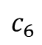
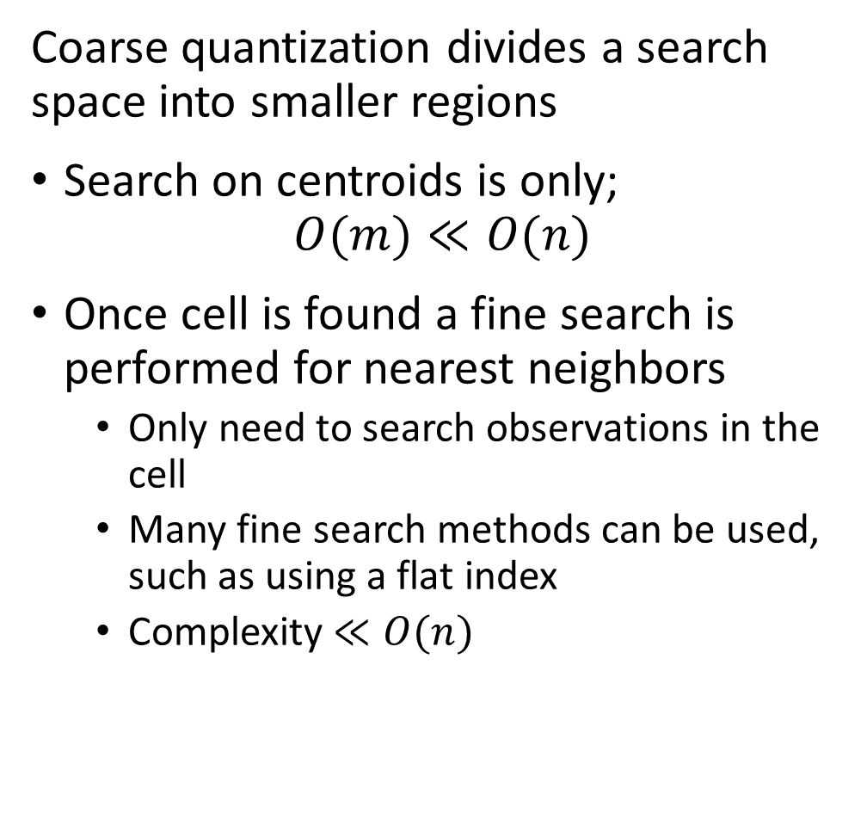
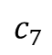
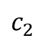
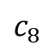
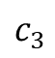
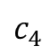
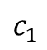
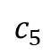
Coarse quantization divides the search region
Coarse quantization divides a search space into smaller regions
Search on centroids is only;
$$O(m)≪O(n)$$
Once cell is found a fine search is performed for nearest neighbors
Only need to search observations in the cell
Many fine search methods can be used, such as using a flat index
Complexity $≪O(n)$
$$c_{3}$$
$$c_{2}$$
$$c_{7}$$
$$c_{1}$$
$$c_{4}$$
$$c_{8}$$
$$c_{6}$$
$$c_{5}$$

Slide 27

Coarse quantization divides the search region
Coarse quantization divides a search space into smaller regions
If the query vector is close to the cell boundary, the NNs can be in other cells
Solution is to prob surrounding cells to expand range of search
The nprob attribute in FAISS sets the number of cells to prob
The larger nprob the slower the query
$$c_{3}$$
$$c_{2}$$
query
$$c_{7}$$
$$c_{1}$$
$$c_{4}$$
$$c_{8}$$
$$c_{6}$$
$$c_{5}$$

Slide 28

Coarse quantization divides the search region
Coarse quantization divides a search space into smaller regions
Example: For Euclidean norm, search space divided into Veroni cells
Veroni cell are convex
The code book for the cells is the list of centroids
$$C=\left[c_{1},c_{2},c_{3},…,c_{m}\right]$$

Slide 29
Product Quantization

Slide 30
Product Quantization
Product Quantization (PQ) for ANNS was first proposed by Jégou, Douze, and Schmid, 2011
Factor observation vectors into subvectors
Factor query vectors into subvectors
Find codes (centroids) by K-means clustering subvectors
Build asymmetric distance tables between subvector centroids and query subvectors
Encode observations subvectors as cluster centroids
Use distance table for NN search for query subvectors
compute distances by summing subvector distances
Database construction
a.k.a. model training
NN search for query

Slide 31

Product Quantization
Product Quantization (PQ) quantizes subvectors of the observations
In contrast to coarse quantization, the PQ algorithm quantizes $m$ subvectors of the $D$ dimensional vector $x$
$$x=\left[x_{1},..,x_{D/m},…,x_{D−\frac{D}{M}+1},..,x_{D}\right]$$
Each of the $m$ subvectors have an independent code book with $p$ quantization levels
$$C_{m}={\left[c_{1,m},c_{2,m},c_{3,m},…,c_{p,m}\right]}_{m}$$
Where code for subvector $m$ minimizes distance or quantization error to the subvector $x_{p}$
$$i_{i}\left(x_{m}\right)=\underset{i}{argmin}{d\left(x_{m}, c_{i,m}\right)}=\underset{i}{argmin}{{\left\|x_{m}−c_{i,m}\right\|}^{2}}$$
Subvector 1
Subvector p

Slide 32

Product Quantization
Product Quantization (PQ) for ANNS was first proposed by Jégou, Douze, and Schmid, 2011
The code or centroid for subvector $m$ minimizes distance or quantization error to the subvector $x_{m}$
$$c_{i,m}=\underset{i}{argmin}{d\left(x_{m}, c_{i,m}\right)}=\underset{i}{argmin}{{\left\|x_{m}−c_{i,m}\right\|}^{2}}$$
As we already noted, there is no feasible exact algorithm for this minimization
For Euclidean metric we typically use Lloyd’s algorithm – a.k.a. k-means clustering
A code book is constructed for each of the $m$ subvectors

Slide 33


Product Quantization
Product Quantization (PQ) quantizes subvectors of the observations
Each of the $m$ subvectors have an independent code book with $p$ quantization levels
$$C_{m}={\left[c_{1,m},c_{2,m},c_{3,m},…,c_{p,m}\right]}_{m}$$
Example from Chris McCormick’s blog post on the PQ algorithm

Slide 34

Product Quantization
Product Quantization (PQ) for ANNS was first proposed by Jégou, Douze, and Schmid, 2011
Each of the $p$ subvectors have an independent code book with $m$ quantization levels
$$C_{m}={\left[c_{1,m},c_{2,m},c_{3,m},…,c_{p,m}\right]}_{m}$$
The full vector is encoded by $p$ codes (quantization levels)
$$i\left(x\right)=\left[i_{1}\left(x_{1}\right),i_{2}\left(x_{2}\right),…,i_{p}\left(x_{p}\right)\right]$$
The codes for each subvector is coded with $p$ levels, encoded by $b$ bits
$$b=\log_{2}\left(p\right)$$
Example, using a one byte (8 bit) code the centroid code has discrete values:
$$p=2^{8}=256 levels$$

Slide 35

Product Quantization
Product Quantization (PQ) for ANNS was first proposed by Jégou, Douze, and Schmid, 2011
PQ coding is invertible, $i^{−1}$, so we can approximately reconstruct the original vector
$$x≈\tilde{x}=i^{−1}\left(x_{i}\right)=i^{−1}\left[\begin{matrix}x_{1} \\ x_{2} \\ \begin{matrix}⋮ \\ x_{p}\end{matrix}\end{matrix}\right]=\left[\begin{matrix}c_{1,m} \\ x_{2,m} \\ \begin{matrix}⋮ \\ x_{p,m}\end{matrix}\end{matrix}\right]$$

Slide 36



Product Quantization
Product Quantization (PQ) is memory efficient
The complete code book for each subvector, $A$, is represented by a $N×p$ array
Example, with $p=256$ the full code book is an $N×256$ array
Example of compression
Vector length, $D=1024$, memory for float
$=4×8×1024=32768$ bits
Number of subvectors, $m=8$
Number of code levels, $p$, with $b=8{⟶p=2}^{8}=256$ levels
Total codes per vector, $m×2^{b}=8×256=2048$
Compression factor $=\frac{32768}{8×8}=512$
$$m$$
0 ,0
0 ,1
. . .
0 ,k-1
1 ,0
1 ,1
. . .
1 ,k-1
2 ,0
2 ,1
. . .
2 ,k-1
3 ,0
3 ,1
. . .
3 ,k-1
$$N$$
.
.
.
.
.
.
.
.
.
N-2 ,0
N-2 ,1
. . .
N-2 ,k-1
N-1,0
N-1,1
. . .
N-1,k-1

Slide 37



Product Quantization
Product Quantization (PQ) queries use asymmetric distance (ASD) calculations
A naïve algorithm for PQ ANNS requires expanding the compressed vectors
This process is invertible and is therefore symmetric
ASD provides an efficient look-up method for ANNS
For the ASD algorithm distances are computed between the $m$ subvectors of the query, $q$, and the subvectors of the $p$ centroids, $c_{i}$
This process is not investable and is therefore asymmetric
The result is a lookup table of dimension $p×m$
NN search on the lookup table is fast
$$m$$
0 ,0
0 ,1
. . .
0 ,-1
1 ,0
1 ,1
. . .
1 ,m-1
2 ,0
2 ,1
. . .
2 ,m-1
$$p$$
3 ,0
3 ,1
. . .
3 ,m-1
.
.
.
.
.
.
.
.
.
k-2 ,0
N-2 ,1
. . .
k-2 ,m-1
k-1,0
N-1,1
. . .
k-1,k-1

Slide 38


Product Quantization
Product Quantization (PQ) uses asymmetric distance calculations (ASD)
$$m$$
0 ,0
0 ,1
. . .
0 ,-1
1 ,0
1 ,1
. . .
1 ,m-1
2 ,0
2 ,1
. . .
2 ,m-1
$$p$$
3 ,0
3 ,1
. . .
3 ,m-1
.
.
.
.
.
.
.
.
.
k-2 ,0
N-2 ,1
. . .
k-2 ,m-1
k-1,0
N-1,1
. . .
k-1,k-1

Slide 39

Performance of the PQ algorithm
The PQ algorithm has two key hyperparameters
$m$: increasing the number of subvectors decreases the quantization error
As the number of subvectors increases the size of the code book increases
As the number of subvectors increases the computational complexity increases
$p$, increasing the number of quantization levels decreases the quantization error
As the number of quantization levels increases the size of the code book increases
As the number of quantization levels increases the computational complexity increases
Low Memory -Scalable
Increasing p and m
Increasing p and m
Low Computational Complexity-Scalable
High Recall -Accuracy

Slide 40

Improving Basic Quantization
Quantization algorithms can be formulated in terms residuals
We can perform similarity search using differences or residuals with respect to the centroid
Idea proposed by Schicong, et.al., 2015, and others
Example from Chris McCormick’s blog post on the PQ algorithm

Slide 41

Improving Basic Quantization
Quantization algorithms can be formulated in terms residuals
We can perform similarity search using differences or residuals with respect to the centroid
Consider the Euclidean distance calculation between a query vector, $q$, and another vector, $x$, with centroid, $c$, with dimension $D$
$$d^{2}\left(x−c,q−c\right)=\sum_{i=1}^{D}{{\left[\left(x_{i}−c_{i}\right)−\left(q_{i}−c_{i}\right)\right]}^{2}=\sum_{i=1}^{D}{{\left[x_{i}−q_{i}\right]}^{2}}=d^{2}\left(x,q\right)}$$
Computing distances with just residuals has no advantage, so why bother?

Slide 42

Improvements Basic Product Quantization
Quantization algorithms can be formulated in terms residuals
What is the advantage of using residuals, since we get the same result either way?
The variance of the residuals, and therefore the error of distance estimates is reduced!
Using residuals for distance estimates are zero-centered, analogous to zero-centering variables for machine learning
Example from Chris McCormick’s blog post on the PQ algorithm

Slide 43
Hierarchical Navigable Small World (HNSW) Graphs

Slide 44
Hierarchical Navigable Small World Graphs
Hierarchical navigable small world (HNSW) graphs for ANNS where first proposed for ANNS by Malkov and Yashunin, 2011
A HNSW graph performs an ANNS on a hierarchy of graphs in two greedy search steps
Search through hierarchy from top to bottom with increasing detail, ‘zooming in’
Search at most detailed level, ‘zooming out’
HNSW graphs incorporate several concepts
Proximity graphs
Probabilistic hierarchical search
Navigable small world graphs

Slide 45
Hierarchical Navigable Small World Graphs
Hierarchical navigable small world (HNSW) graphs for ANNS where first proposed for ANNS by Malkov and Yashunin, 2011
Start search by selecting node in top layer
Find nearest neighbor to the query vector in the top layer
Zoom In
Use nearest neighbor from previous layer as starting point
Search next layer for nearest neighbor
Use nearest neighbor from previous layer as starting point
Zoom Out
Search bottom layer for nearest neighbor
Nearest neighbor search on HNSW graph

Slide 46
Hierarchical Navigable Small World Graphs
Hierarchical navigable small world (HNSW) graphs for ANNS where first proposed for ANNS by Malkov and Yashunin, 2011
A HNSW graph performs an ANNS on a hierarchy of graphs in two greedy search steps
Search through hierarchy from top to bottom with increasing detail, ‘zooming in’
Search at most detailed level, ‘zooming out’
HNSW graphs incorporate several concepts
Proximity graphs
Navigable small world graphs
Probabilistic hierarchical search

Slide 47


Proximity Graphs
Nearest neighbor (NN) graphs are an example of proximity graphs
Presentence of edges in a proximity graph (index) determined by distance or similarity between nearest neighbors
Searches on a proximity graph finds $k$ nearest neighbors
Notice that nodes must have number of edges $m>k$ for search to succeed
You can find more detail on proximity graphs in a number of sources, including Mengzhao Wang’s blog post
Diagram credit, Mengzhao Wang

Slide 48


Navigable Small World Graphs
Navigable small world (NSW) graphs are defined as having high clustering coefficients and distance growing as $O(\log\left(n\right))$
A small world graph exhibits high association between nodes resulting from high clustering
NSW graphs have both short-range connections between near neighbors and long-range connections

Slide 49


Navigable Small World Graphs
Navigable small world (NSW) graphs are a form of proximity graph
Connectivity determined by number of edges per node ($M$ in FAISS or $p$ in NetworkX)
As the $M⟶N$ the proximity graph becomes fully connected
Clustering coefficient increases and average distance decreases as average number of connections per node increase

Slide 50


Navigable Small World Graphs
Navigable small world (NSW) graphs are defined as having high clustering coefficients and distance growing as $O(\log\left(n\right))$
Clustering coefficient increases and average distance decreases as average number of long-range connections ($q$ in NetworkX) per node increase
NSW graphs have relatively few hub nodes with high degree compared to other nodes

Slide 51
Hierarchical Navigable Small World Graphs
Hierarchical Navigable small world (HNSW) graphs enable efficient and scalable ANNS
Malkov, et. al., 2014 applied NSW graphs to the ANNS problem
In some cases, a greedy search on a NSW effectively finds the NNs
If the graph exhibits considerable clustering only a sub-optimal local solution will be found
In other cases the search path can be long
Using a hierarchy of NSW graphs is more robust and helps to overcome these problems

Slide 52

Hierarchical Navigable Small World Graphs
Hierarchical Navigable small world (HNSW) graphs enable efficient and scalable ANNS
The hierarchy of NSW graphs creates a skip list
Skip-list search was introduced by Pugh, 1990, as a fast search algorithm
A skip-list is a form of linked list using a hierarchy of long-range and short-range links
Links connecting observations are sampled probabilistically
Diagram credit, Pugh, 1990

Slide 53

Hierarchical Navigable Small World Graphs
Hierarchical Navigable small world (HNSW) graph has $m$ layers comprised of NSW graphs of increasing resolution
The highest level of the hierarchy has the longest-range edges
The search proceeds to increasingly finer detail levels
The lowest level contains all nodes and the most detail
query
Level 2
query
Level 1
query
Level 0

Slide 54

Hierarchical Navigable Small World Graphs
Hierarchical Navigable small world (HNSW) graph has $m$ layers comprised of NSW graphs of increasing resolution
The search at the highest level begins at an chosen entry node
The graph is traversed in a greedy manner until the node closest to the query is found
Searches at subsequent levels are the ‘zoom in’ phase of the search
query
Level 2

Slide 55

Hierarchical Navigable Small World Graphs
Hierarchical Navigable small world (HNSW) graph has $m$ layers comprised of NSW graphs of increasing resolution
The NN node at the previous level is used as the entry point for a greedy search at the next level of the hierarchy
Greedy search at next level of detail finds next NN node
The foregoing steps are repeated until bottom level is reached
query
Level 2
query
Level 1

Slide 56

Hierarchical Navigable Small World Graphs
Hierarchical Navigable small world (HNSW) graph has $m$ layers comprised of NSW graphs of increasing resolution
The NN node at the previous level is used as the entry point for a greedy search at the lowest level of the hierarchy
Greedy search at the lowest level is has full detail, finding NN nodes
The lowest level search is the ‘zoom out’ phase
query
Level 2
query
Level 1
query

Slide 57

Constructing NSW Graphs
The construction process for HNSW graphs is similar to the query process
A hierarchical NN search is used to find the location of the new element on the HNSW graph
The level of the new element is determined by probabilistically sampling from an exponential decay distribution over levels, $\left[0, 1,…, M\right]$
$P\left[0\right]>uniform(0,1)$
$P\left[1\right]>uniform\left(0,1\right)−P\left[0\right]$
$P\left[2\right]>uniform\left(0,1\right)−P\left[1\right]$
…
else, $M−1$
Notice the rapid decay of this distribution $P\left[0\right]≫P\left[1\right]≫P\left[2\right]≫…$
Detail increases rapidly with depth in the hierarchy, improving search speed

Slide 58
Optimizing HNSW graph
The HNSW ANNS has several hyperparameters that affect performance
M determines the number of edges each node in the graph has.
Limits are set by M_max and M_max0 limit the number of edges in the layers and in the bottom layer, 0, with defaults M_max = M and M_max0 = 2*M
efConstruction sets the number of entry points used when building the index
efSearch sets the number of entry points used for the NN search

Slide 59
Optimizing HNSW ANNS
Low Memory -Scalable
The HNSW ANNS has several hyperparameters that affect performance
M determines the number of edges each node in the graph has.
Limits are set by M_max and M_max0 limit the number of edges in the layers and in the bottom layer, 0, with defaults M_max = M and M_max0 = 2*M
efConstruction sets the number of entry points used when building the index
efSearch sets the number of entry points used for the NN search
Increasing M
Increasing M and ef’s
Low Computational Complexity-Scalable
High Recall -Accuracy

Slide 60

Optimizing HNSW graph
The HNSW ANNS has several hyperparameters that affect performance
ANNS on HNSW can achieve high recall but at a price

Slide 61

Optimizing HNSW graph
The HNSW ANNS has several hyperparameters that affect performance
Achieving higher recall with HNSW ANNS increases search time significantly

Slide 62

Optimizing HNSW graph
The HNSW ANNS has several hyperparameters that affect performance
Achieving higher recall with HNSW ANNS increases memory consumption significantly

Slide 63
Concatenating Indices

Slide 64
Concatenating Indices
For optimal ANNS performance multiple indices are concatenated
While single indices can achieve good recall, it is unreasonable to expect optimal performance
Optimal performance is obtained by concatenating indices
Distance (Similarity) Metric
Dimensionality Reduction (Embedding)
Create D dimensional numeric embedding vectors
PCA
Neural Embedding
Etc.
Coarse Quantization
Reduce scope for ANN search
Inverted file - IVF
IVF Product quantization (IVF-PQ)
Inverted Multi-Index (IMI)
IVF Hierarchical Navigable Small Worlds (HNSW)
Etc…
Fine Quantizaton
Further reduce search scope and improve recall
Exhaustive search – Flat
Residual PQ
Locally Sensitive Hashing (LSH)
Search Refinemnet
Increase recall for NN search
Flat
Residual PQ algorithm

Slide 65

Concatenating Indices
For optimal ANNS performance multiple indices are concatenated
The FAISS index factory simplifies creation of concatenated indices
FAISS allows a complex set of choices for concatenated indices

Slide 66

Concatenating Indices
How can we construct effective concatenated indicies?
Be careful! Order maters for concatenated indicies!
Many purmutations do not make sense
Concatenated indices must work from coarse to fine
Example of using FAISS index factory
Dimension of input vector
String specifying concatenated operations
index = index_factory(128,"OPQ16_64,IMI2x8, PQ32x8")
Where:
OPQ16_64: optimized PQ coarse quantizer with $m=16$ and output dimension 64
IMI2x8: inverted multi-index with 2 dismensions and $2^{b}=2^{8}=256$ levels
PQ32x8: PQ fine quantizer with $m=32$ and $2^{b}=2^{8}=256$ levels

Slide 67
Building KD-Trees

Slide 68

KD-Trees
KD-trees partition lower dimensional spaces
KD-tree is constructed by binary partitions of low-dimensional data
For $k$ dimensional data of size $n$, KD-tree algorithm has computational complexity:
Construction has complexity $O(k n\log{n})$
Query has complexity $O(\log{n})$
Insert has complexity $O(\log{n})$
Delete has complexity $O(\log{n})$
Find k nearest-neighbor by query on KD-tree with $O\left(n\right)$ complexity
Similarity search with $k=1$
KD-tree algorithm scales for massive datasets
KD-tree is generally considered an efficient algorithm if
$$n≫2^{k}, or k<20$$
Related ball-tree algorithms are generally considered more scalable

Slide 69
KD-Trees
A KD-tree is constructed by binary partitions through these steps
Start with the set of observations
Number of observations per leaf is defined – a hyperparameter
Splits are along the axes of the data space
Axes are sampled round-robin or randomly
On each axis split point is determined
Split is on observation closest to median, mean or other measure
Splitting hyperplane is perpendicular to the axis selected
Observations in region split are partitioned left and right of hyperplane
Repeat steps 2-6 until leaf has less than required number of observations
The termination condition

Slide 70
KD-Trees
Many sources discussing details of KD-tree algorithms, their limitations and the pitfalls, with a few suggestions
Chapter from Andrew Moore’s PhD dissertation
Chapters 8, 9, 10, 11 of Advanced Algorithms and Data Structures, Marcello La Rocca, Manning, 2021
Wikipedia article
For a fairly theoretical but comprehensive review paper on approximate nearest neighbor search algorithms see Andoni, Indyk and Razenshteyn, 2018

Slide 71



KD-Trees
KD-trees are constructed by binary partitioning
Start with some data points in a 2-dimensional space, $k=2$
Set number of nodes in leaves to 1
Root of the tree is NULL
$$x_{2}$$
A
B
C
J
J
D
E
G
F
I
H
$$x_{1}$$

Slide 72

KD-Trees
KD-trees are constructed by binary partitioning
Partition the data by the value closest to the median of along the first axis, $x_{1}$
The first partition becomes the root of the tree
E
$$x_{2}$$
A
B
C
J
J
D
E
G
F
I
H
$$x_{1}$$

Slide 73

KD-Trees
KD-trees are constructed by binary partitioning
There are nearly balanced numbers of observations on each side of the partition
Next, along $x_{2}$ partition the left and right partitions by the values nearest the medians
E
$$x_{2}$$
A
B
D
G
C
J
J
D
E
G
F
I
H
K
$$x_{1}$$

Slide 74

KD-Trees
KD-trees are constructed by binary partitioning
Continue to partition, round robin back to $x_{1}$
Single node is a leaf of the tree
E
$$x_{2}$$
A
B
D
G
C
J
J
J
H
C
K
D
E
G
F
I
H
K
$$x_{1}$$

Slide 75
KD-Trees
KD-trees are constructed by binary partitioning
Now there are only leaves to add to the tree
E
$$x_{2}$$
A
B
D
C
G
J
J
J
H
C
K
D
E
G
A
B
J
F
I
F
I
H
K
$$x_{1}$$

Slide 76
Similarity Queries on KD-Trees

Slide 77

KD-Trees
Query KD-tree to determine nearest neighbors
Start at the root
Head left or right from node based on split value and sample value
Determine distance for nearest neighbor search
Usually use Euclidean distance, but can use other metrics
Repeat step 2 until leaves encountered
Determine distance for nearest neighbor search
Backtrack to other branches to determine if NN missed
Prune branches if distances are not NNs
Pruning gives $O\left(n\right)$ computational complexity

Slide 78
KD-Trees
Can rapidly perform 3-nearest neighbor query a KD-Tree by following the node splits
Start with a new observation, Z
E
$$x_{2}$$
A
B
D
C
G
J
J
J
H
C
K
D
E
G
A
B
J
F
I
F
Z
I
H
K
$$x_{1}$$

Slide 79

KD-Trees
Can rapidly 3-nearest neighbor query a KD-Tree by following the node splits
The value of $x_{1}$ for Z is greater than $x_{1}$ of E
So branch right to G, find distance
E
$$x_{2}$$
A
B
D
C
G
J
J
J
H
C
K
D
E
G
A
B
J
F
I
F
Z
I
H
K
$$x_{1}$$

Slide 80

KD-Trees
Can rapidly 3-nearest neighbor query a KD-Tree by following the node splits
The value of $x_{2}$ for Z is less than $x_{2}$ of G
So branch right to K, find distance
E
$$x_{2}$$
A
B
D
C
G
J
J
J
H
C
K
D
E
G
A
B
J
F
I
F
Z
I
H
K
$$x_{1}$$

Slide 81
KD-Trees
Can rapidly 3-nearest neighbor query a KD-Tree by following the node splits
Z has nearest neighbors on graph I, G, K
But is there a nearer neighbor on the graph?
E
$$x_{2}$$
A
B
D
C
G
J
J
J
H
C
K
D
E
G
A
B
J
F
I
F
Z
I
H
K
$$x_{1}$$

Slide 82
KD-Trees
Can rapidly 3-nearest neighbor query a KD-Tree by following the node splits
We need to backtrack to determine if there is a nearer neighbor on another branch
Backtracking to K then to branch with F, finding a nearer neighbor than K
E
$$x_{2}$$
A
B
D
C
G
J
J
J
H
C
K
D
E
G
A
B
J
F
I
F
Z
I
H
K
$$x_{1}$$

Slide 83
KD-Trees
Can rapidly 3-nearest neighbor query a KD-Tree by following the node splits
Continue backtracking to K then to branch to C and J, but no nearer neighbor
We can prune the branch with C and J from the search
E
$$x_{2}$$
A
B
D
C
G
J
J
J
H
C
K
D
E
G
A
B
J
F
I
F
Z
I
H
K
$$x_{1}$$

Slide 84
KD-Trees
Can rapidly query a KD-Tree by following the video splits
The backtrack arrives at the root, terminating the algorithm
E
$$x_{2}$$
A
B
D
C
G
J
J
J
H
C
K
D
E
G
A
B
J
F
I
F
Z
I
H
K
$$x_{1}$$

Slide 85
Mini-Hashes and Sketches For Similarity Search

Slide 86

Locally Sensitive Hashing
Locally sensitive hashing (LSH) is a computationally efficient method to measure similarity in high dimensional spaces
LSH algorithms perform approximate similarity search with $O\left(n\right)$ complexity for high dimensional space
LSH algorithms can be applied to categorical and numeric data
Jaccard similarity
Hamming similarity
Euclidean similarity
Cosign similarity
Etc.

Slide 87
Locally Sensitive Hashing
Example, process flow for LSH for document similarity
Goal is to perform similarity search between documents in corpus
Process involves three steps
Similar workflow for images and other content
Document Corpus
Mini-hashing to create sketch
Similarity approximated by LSH
Shingling of document

Slide 88
Locally Sensitive Hashing

Slide 89

Locally Sensitive Hashing
Probability of error from mini-hashing
Consider the Jaccard similarity between two documents:
${sim}_{Jaccard}\left(s_{i},s_{j}\right)=s$
The probability that all $r$ mini-hashes agree is: $s^{r}$
The probability that at least 1 of the mini-hashes disagree: $1−s^{r}$

Slide 90

Locally Sensitive Hashing
Probability of error from mini-hashing
The probability that all $r$ mini-hash signatures agree is: $s^{r}$
The probability that at least 1 of the mini-hashes disagree: $1−s^{r}$
For $r=5$ we see the following sensitivity of the decision function:
The sensitivity to positive cases is low, poor sensitivity to discoveries!
S | Probability Positive | Probability Negative | Expected Positive Pairs per 1000
0.1 | 1.0000E-05 | 9.9999E-01 | 0.01
0.2 | 3.2000E-04 | 9.9968E-01 | 0.32
0.3 | 2.4300E-03 | 9.9757E-01 | 2.43
0.4 | 1.0240E-02 | 9.8976E-01 | 10.24
0.5 | 3.1250E-02 | 9.6875E-01 | 31.25
0.6 | 7.7760E-02 | 9.2224E-01 | 77.76
0.7 | 1.6807E-01 | 8.3193E-01 | 168.07
0.8 | 3.2768E-01 | 6.7232E-01 | 327.68
0.9 | 5.9049E-01 | 4.0951E-01 | 590.49

Slide 91
Locally Sensitive Hashing
Probability of error from mini-hashing
Using mini-hashes yields low sensitivity to positive cases
How can we improve on local sensitivity?
We employ b bands of r mini-hashes per band
Signature 1
Band 1
Signature 2
…
Signature r
Signature 1
Band 2
Signature 2
…
Signature r
…
Signature 1
Band b
Signature 2
…
Signature r

Slide 92

Locally Sensitive Hashing
Probability of error from mini-hashing
With $b$bands of $r$ mini-hashes we can find the sensitivity of positives for a given Jaccard similarity between two documents
The probability for $b$ bands that all $r$ mini-hashes agree is: ${\left(s^{r}\right)}^{b}$
The probability that at least 1 of the $r$ mini-hashes disagree in the $b$ bands: $1−{\left(1−s^{r}\right)}^{b}$

Slide 93

Locally Sensitive Hashing
Probability of error from banded mini-hashing
For $r=5$ and $b=20$ we find the following sensitivities:
Sensitivity to positive cases has increased significantly!
Some increase in false positive cases, increased false discovery rate
S | Probability Positive | Probability Negative | Expected Positive Pairs per 1000
0.1 | 1.9998E-04 | 9.9980E-01 | 0.20
0.2 | 6.3806E-03 | 9.9362E-01 | 6.38
0.3 | 4.7494E-02 | 9.5251E-01 | 47.49
0.4 | 1.8605E-01 | 8.1395E-01 | 186.05
0.5 | 4.7005E-01 | 5.2995E-01 | 470.05
0.6 | 8.0190E-01 | 1.9810E-01 | 801.90
0.7 | 9.7478E-01 | 2.5219E-02 | 974.78
0.8 | 9.9964E-01 | 3.5606E-04 | 999.64
0.9 | 1.0000E+00 | 1.7591E-08 | 1000.00

Slide 94

Locally Sensitive Hashing
Probabilities from banded mini-hashing

Slide 95

Locally Sensitive Functions
Model to understand locally sensitive hashing
Set thresholds, $d_{1}$ and $d_{2}$, to define a decision rule
Consider distance measures $d\left(x, x^{′}\right)$ generated from a family of functions, $f\left(x\right) ε ℱ$ with decision rule:
If $d\left(x,x^{′}\right)≤d_{1}$, then $p\left(f\left(x\right)=f\left(x′\right)\right)≥p_{1}=p(match)$
and $d\left(x,x′\right)≥d_{2}$, then $p\left(f\left(x\right)=f\left(x′\right)\right)≤p_{2}=p(false match)$
We say $ℱ$ is $\left(d_{1},d_{2},p_{1},p_{2}\right)$ sensitive
Consider how local sensitivity is constructed for Jaccard similarity:
${sim}_{J}\left(x,x^{′}\right)=1−d_{j}(x,x^{′})$
For mini-hash function $f(x)$, ${sim}_{J}\left(x,x^{′}\right)=p\left(f\left(x\right)=f\left(x′\right)\right)$
Therefore, $ℱ$ is $\left(d_{1},d_{2},1−d_{1},1−d_{2}\right)$ sensitive
It is easy to see the more sensitive the hash function the more sensitive the decision rule

Slide 96

Locally Sensitive Functions
Model to understand locally sensitive hashing
Example of the $\left(d_{1},d_{2}, p_{1}, p_{2}\right)$ family for Jaccard similarity
Set the thresholds $d_{1}=0.3$ and $d_{2}=0.6$
Then:
Probability of match $≥1−d_{1}=1−0.3=0.7$
Probability of false positive $≤1−d_{2}=1−0.6=0.4$
Is a $\left(0.3,0.6, 0.7, 0.4\right)$ family

Slide 97


Locally Sensitive Functions
Model to understand locally sensitive hashing
Can visualize relationship between hash function and sensitivity of the decision rule
Higher sensitivity, smaller $d_{1}$ and larger $d_{2}$, increases probability of correct decision
False Negative
False Positive
Credit; Leskovec et.al. 2020

Slide 98
Improving LSH

Slide 99

Improving Locally Sensitive Functions
How can we improve local sensitivity of a family of functions $ℱ$?
Start with $sen\left(ℱ\right)=\left(d_{1},d_{2},p_{1},p_{2}\right)$
Construct a new family from $ℱ$, called $ℱ′$ by AND-construction
Construct family from $r$ distance function: $ℱ^{′}=\left\{f_{1},f_{2},…,f_{r}\right\}$
Assuming independence of the distance functions:
$$sen\left(ℱ^{′}\right)=\left(d_{1},d_{2},{( p_{1}^{ })}^{r},{(p_{2})}^{r}\right)$$
AND-construction uses agreement – logical AND
AND-construction decreases both decision thresholds, since $p_{1}^{ },p_{2}^{ }<1$

Slide 100

Improving Locally Sensitive Functions
How can we improve local sensitivity of a family of functions $ℱ$?
Can also use OR-construction
Construct family from $b$ distance function: $ℱ^{′}=\left\{f_{1},f_{2},…,f_{b}\right\}$
Assume independence of the distance functions:
$$sen\left(ℱ^{′}\right)=\left(d_{1},d_{2},{1−( 1−p_{1}^{ })}^{b},{1−({1−p}_{2})}^{b}\right)$$
OR-construction is positive if any mini-hash exceeds threshold – OR operator
OR-construction increases both decision thresholds, since $p_{1}^{ },p_{2}^{ }<1$

Slide 101

Improving Locally Sensitive Functions
How can we improve local sensitivity of a family of functions $ℱ$?
Can get the best of both by combining AND-construction and OR-construction
r hashes per band
d bands
Option 1: AND-OR-Construction – apply AND-Construction first then apply OR-Construction, giving sensitivity:
$$1−{\left(1−p^{r}\right)}^{b}$$
Option 2: OR-AND-Construction – apply OR-Construction first then apply AND-Construction, giving sensitivity:
$${\left(1−{\left(1−p\right)}^{b}\right)}^{r}$$

Slide 102

Improving Locally Sensitive Functions
How can we improve local sensitivity of a family of functions $ℱ$?
Example: $d=4$ and $r=4$
Increased sensitivity for both constructions
AND-OR-Construction slightly biased to negative cases
OR-AND-Construction slightly biased to positive cases
p | AND-OR-Construction | OR-AND-Construction
0.1 | 3.9994E-04 | 1.3987E-02
0.2 | 6.3847E-03 | 1.2150E-01
0.3 | 3.2008E-02 | 3.3345E-01
0.4 | 9.8535E-02 | 5.7395E-01
0.5 | 2.2752E-01 | 7.7248E-01
0.6 | 4.2605E-01 | 9.0147E-01
0.7 | 6.6655E-01 | 9.6799E-01
0.8 | 8.7850E-01 | 9.9362E-01
0.9 | 9.8601E-01 | 9.9960E-01

Slide 103


Improving Locally Sensitive Functions
How can we improve local sensitivity of a family of functions $ℱ$?
Example: AND-OR construction of LSH decision function
Optimal choice of $b,r$ given $n$
Notice, slope of decision function increases with $n$

Slide 104

Efficient LSH
What is an efficient algorithm for LSH?
Pairwise comparison is inefficient
$\frac{n(n−1)}{2}$ pairs
Computational complexity $O\left(n^{2}\right)$
Or $O\left(k n\log{n}\right)$ for KD-tree
Use hash buckets to find candidate pairs
Band of signature matrix hash to bucket
More than one hash in bucket is candidate pair
Hashing algorithm with computational complexity $O\left(n^{ }\right)$!

Slide 105
Efficient LSH
Candidate 1
Candidate 2
Hash Table
Signature 1
Signature 1
Hash 1
Efficient algorithm for LSH uses hash table
Start with hash table
Signatures arranged in bands
Hash signatures in bands to hash buckets
Match hash to same bucket indicates high similarity
Band 1
Signature 2
Signature 2
Hash 2
…
…
Hash 3
Signature r
Signature r
Hash 4
Signature 1
Signature 1
Hash 5
Band 2
Signature 2
Signature 2
Hash 6
…
…
Hash 7
Signature r
Signature r
Hash 8
…
…
…
Signature 1
Signature 1
Hash n-2
Band b
Signature 2
Signature 2
Hash 2 n-1
…
…
Hash n
Signature r
Signature r

Slide 106
LSH With Other Similarity Metrics

Slide 107

LSH with Hamming Distance
Can create a locally sensitive hash family from Hamming distance
Hamming distance, $h\left(x,y\right)$, is number of symbol differences between two strings
For strings of length l, $f_{i}\left(x\right)=f_{i}\left(y\right)$ iff vectors x and y agree in ith position with probability $1−h\left(x,y\right)/l$
For the hash family, $ℱ=\{f_{1},f_{2},f_{3},…,f_{d}\}$:
$$sen\left(ℱ\right)=\left(d_{1},d_{2},p_{1},p_{2}\right)=(d_{1},d_{2},1−\frac{d_{1}}{l},1−\frac{d_{2}}{l})$$
For string length l limited to l hashes
Limits steepness of the decision function

Slide 108
LSH for Numeric Variables
How can LSH be applied to numeric variables?
Can create hashes to estimate cosine distance
Cosine distances computed with numeric (real) variables
Uses computationally efficient dot products as hashes
Apply LSH to find cosine distance estimates

Slide 109


LSH for Numeric Variables
Review Cosine Similarity
$$d\left(x,x^{′}\right)=cos\left(θ_{i}\right)=\frac{x∙x′}{\left|x\right|\left|x′\right|}$$
Points at (2,1) and (4,3)
What is the distance between them?
Cosine distance
$$dcos\left(x,x^{′}\right)=\frac{2∗4 +1∗3}{{\left(2^{2}+1^{2}\right)}^{1/2}{\left(4^{2}+3^{2}\right)}^{1/2}}= \frac{11}{5^{1/2}{25}^{1/2}}=0.984$$
(4,3)
X₂
θ
(2,1)
X₁

Slide 110

LSH for Numeric Variables
Create hashes with random hyperplanes
Start with two vectors, x,y
Choose a hyperplane H at random
Hyperplane defined by a perpendicular vector, v
$$H⋅v=0$$
Dot products of v with x, y have opposite signs:
$$y⋅v⇒+$$
$$x⋅v⇒−$$
Or if v has opposite sign:
$$y⋅−v⇒−$$
$$x⋅−v⇒+$$
y
v
θ
x
H

Slide 111

LSH for Numeric Variables
Create hashes with random hyperplanes
Choose another hyperplane H at random with orthogonal vector v
Dot products of v with x,y have same signs:
$$y⋅v⇒+$$
$$x⋅v⇒+$$
Or if v has same sign:
$$y⋅−v⇒−$$
$$x⋅−v⇒−$$
Therefore expected probability that dot product with orthogonal vector have opposite signs:
$$E\left[P\left(+,−\right)\right]=θ/π$$
y
v
θ
x
H

Slide 112

LSH for Numeric Variables
The $sen\left(ℱ\right)=\left(d_{1},d_{2},p_{1},p_{1}\right)$ family for cosine distance hashes
Using cosine hashes, $f\left(x\right)=f(y)$ iif the dot products x$⋅v$ and $y⋅v$ have the same sign, then:
$$sen\left(ℱ\right)=\left(d_{1},d_{2},p_{1},p_{2}\right)=(d_{1},d_{2},\frac{\left(π−d_{1}\right)}{π},\frac{\left(π−d_{2}\right)}{π})$$

Slide 113

LSH for Numeric Variables
Use sketches to simplify cosine distance LSH
Need to compute a number of hashes to accurately estimate $θ$
Must average out error of each hash (estimate)
Sketches can speed this calculation
Use random vectors with $±1$ values,
Example, $\left[+1,−1,−1,+1,…,−1\right]$
Hash family, $ℱ$, is sign of dot products of variables with random vectors
For n dimensional data, limited to $2^{n}$ possible hashes
Most useful for very high-dimensional variables
See the MMDS book for similar method for Euclidean spaces

Slide 114

Summary
Key points for this lesson
Shingle documents for similarity measures
Set of all shingles organized into characteristic matrix with rows represented by the universal set
Mini-hashing shingles creates signature matrix as compact representation
LSH uses $sen\left(𝓕\right)=\left(d_{1},d_{2},p_{1},p_{2}\right)$ family of hash functions, $ℱ$
LSH creates sigmodal decision function with high slope
AND-OR and OR-AND construction for banded signature matrix creates more sensitive decision function
Cosine similarity and Hamming distance result in $sen\left(ℱ\right)=\left(d_{1},d_{2},p_{1},p_{2}\right)$ hash function families

